Slide 1

Enhancing Sustainable Crop Protection through Machine Learning-Driven Integrated Strategies
TMP-2023-24-074

Slide 2

Team Members
Supervisor : Mr. Vishan Jayasinghearachchi
Co-Supervisor : Mr. Samadhi Rathnayake
Team Member Name | IT Number
Senanayake P.M. | IT20606756
Withanage P.W.E.L. | IT20600334
Wijesinha W.S.S | IT20641092
Anuththara R.M.C | IT20637064

Slide 3
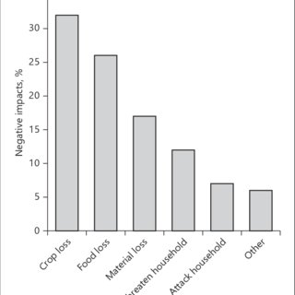


Introduction to the overall project
Increasing crop damage
The decrease in the productivity of cultivated land in Sri Lanka has become a significant issue
Main problems causing increasing crop damage in Sri Lanka
Threat of pest infestations
Fungal diseases and depletion of soil nutrients
Source: Public Perceptions and Solutions to Human-Monkey
Conflict from 50 Years in Sri Lanka [1]

Slide 4
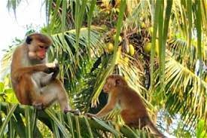
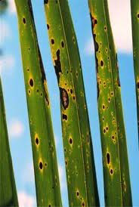
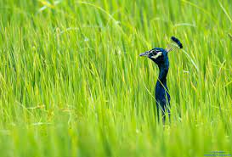
Introduction to the overall project
Threat of pest infestations
Among pests, monkeys can be a significant threat
to agriculture and crops in certain regions
Crop Raiding
Yield Reduction
Fear and Stress for Farmers
Potential for Crop Disease Spread

Slide 5


Introduction to the overall project
Fungal diseases , pest damages and depletion of soil nutrients
Lack of nutrients in the soil directly affects the plant and the yield.
Discoloration of leaves
Leaf shriveling
Fungal damage immediately impairs the life of the plant.
Cause ,
Decreased productivity
Deterioration of productivity

Slide 6
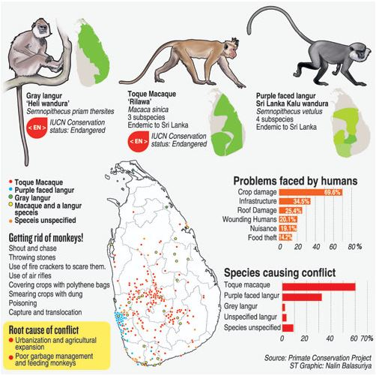
Introduction to the overall project

Slide 7
Research Question
How to Increase the effectiveness of cultivation by preventing external damage to the cultivation
What are the methods to address the present damages that already exist?

Slide 8

Objective
Increasing the effectiveness of cultivation by preventing external damage to the cultivation

Slide 9
Sub Objectives
Identification of Macaque Sounds
Confirmation of macaque monkeys crop raiding, repelling macaque monkeys and notify the farmer
Behavior Pattern Recognition and Prediction
Identification and Give Solutions to existing crop damages

Slide 10






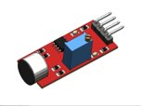







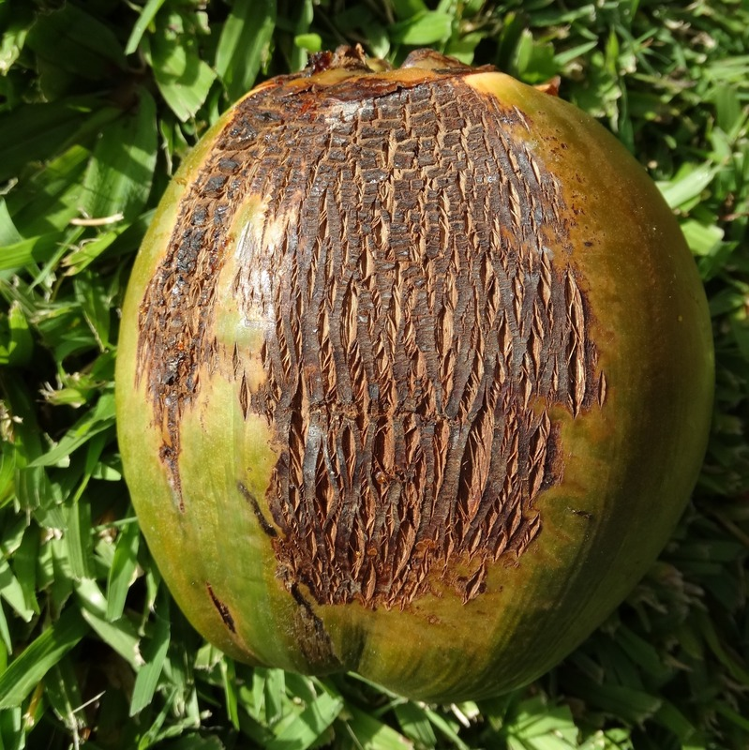
Overall System Diagram
Give camera to signal if suspicious sound detect
ML module
Catch the sounds
Releasing High Frequency
Display the alert
Pre-processing data and Summarized
Detect the
monkeys
Visualizing summarized data
Pre-processing data and Summarized
Input future time period
Display the predicted output
Upload vehicle external damage images
Give the Step-by-step Solution
System detect the disease

Slide 11
References
[1] http://www.colombopage.com/archive_23B/Jul02_1688316295CH.php#:~:text=According%20to%20that%20report%2C%20it,especially%20in%20the%20coconut%20triangle.

Slide 12

IT20641092 | W.S.S Wijesinha
Topic- Preliminary detection of presence of crop raiding macaque monkeys through ambient noise analysis
Bachelor of Science (Hons) in Information Technology
Specializing in Software Engineering
IT20641092 | Wijesinha W.S.S | TMP-2023-24-074

Slide 13

Introduction and Background
Need of macaque arrival detection
Two-step process(detection and confirmation)
Detection needed to inform there can be a macaques in the farm
To second step.
Sometimes macaques are arrived, but they are not making their own sounds. But the sounds of jumping on the branches is noticeable.
Reduce power consumption of the devices used in identifying macaque process is significant.
IT20641092 | Wijesinha W.S.S | TMP-2023-24-074

Slide 14
Research Gap
When discussing about the research gap in relation to this component,
There are no previous researches found conducted in identifying and giving probability to being macaque monkey noises and other suspicious noises made by monkeys.
Real time detecting the different noises and Detecting macaque monkey noises
And other suspicious sounds that macaque monkeys can give.
Finding probability to be a suspicious noise and give preliminary output.
The time that take to trigger the cameras should be less. After Getting voice record time take to provide preliminary output, within less than 10 seconds.
IT206000334 | Withanage P.W.E.L. | TMP-2023-24-074

Slide 15
Reference Research papers
[1]ifan Jiang; Adrian Soldati; Isaac Schamberg, Adriano R. Lameira, Steven Moran1,"AUTOMATIC SOUND EVENT DETECTION AND CLASSIFICATION OF GREAT APE CALLS USING NEURAL NETWORKS", 23 Apr 2023
[2] Sheik Mohammed.S, Dr.T.Sheela, Dr.T.Muthumanickam "Development of Animal-Detection System using Modified CNN Algorithm" Proceedings of the International Conference on Augmented Intelligence and Sustainable Systems (ICAISS-2022)
[3] Yuvaraj Munian, Antonio Martinez-Molina, Miltiadis Alamaniotis "Intelligent System for Detection of Wild Animals Using HOG and CNN in Automobile Applications"
[4] P. Manikandan, A.Thenmozhi , G. Ramesh, T. Ravi Kiran Naidu, K. Vamsinath Reddy, K. BhanuPradeep Kumar Reddy "Crops Protection System from Animals using Arduino" 2021 3rd International Conference on Advances in Computing, Communication Control and Networking (ICACCCN)
[5] Karthikeyan P, Paul Nishanth R, Valarmathi R "CROP FIELD PROTECTION FROM ANIMALS USING CONVOLUTIONAL NEURAL NETWORKS" 2022 1st international Conference on Computational Science and Technology (ICCST)
IT20641092 | Wijesinha W.S.S | TMP-2023-24-074

Slide 16


Research Gap
Research Name | Research 1 | Research 2 | Research 3 | System
Monkey noise and Detect monkey suspicious noticeable noises
Give probability for recorded sounds for being macaque monkey
Real time monitoring
Give signal to camera on
IT20641092 | Wijesinha W.S.S | TMP-2023-24-074

Slide 17

Research Problem
Sometimes macaques are arrived, but they are not making their own sounds.
How to detect the macaques are arrived?
IT20641092 | Wijesinha W.S.S | TMP-2023-24-074

Slide 18
Main Objectives
Preliminary detection of presence of crop raiding macaque monkeys through ambient noise analysis
IT20641092 | Wijesinha W.S.S | TMP-2023-24-074

Slide 19
Sub Objectives
Getting the input data from the device and saving it in a cloud.
Classify audio as macaque noise or non-macaque noise for effective detection
Implement the model by developing the algorithm and calculate the probability to having macaque by considering ambient sounds.
Give preliminary output about having macaque according to the probability
Deployment and real-time detection
IT20641092 | Wijesinha W.S.S | TMP-2023-24-074

Slide 20

Methodology
IT20641092 | Wijesinha W.S.S | TMP-2023-24-074

Slide 21





System Architecture
Monkey
Sounds and branch broken sounds
Save Predicted the result and Give
preliminary output
Detect the sounds
ML module
Give the signal to webcam to on
Implement a module
Store data
'Camera On' log with time
Preprocess data and label
Mobile App
Sound sensor
Detect the suspicious sounds (monkey sounds and other branch breaking sounds) and give signal to camera to on
IT20641092 | Wijesinha W.S.S | TMP-2023-24-074

Slide 22




Tools and Technologies and algorithms
Programming Languages
Python
Database Service
Azure
Algorithms
Binary Classification
YOLO
Tools
Visual Studio code ,Version controlling - SourceTree
IT20641092 | Wijesinha W.S.S | TMP-2023-24-074

Slide 23
Functional Requirements
Audio data collection
Sound analysis
Sound classification
Predict the probability
Give preliminary output
Output presentation
IT20641092 | Wijesinha W.S.S | TMP-2023-24-074

Slide 24
Non-Functional Requirements
Performance
Maintainability
Reliability
Scalability
Robustness
IT20641092 | Wijesinha W.S.S | TMP-2023-24-074

Slide 25
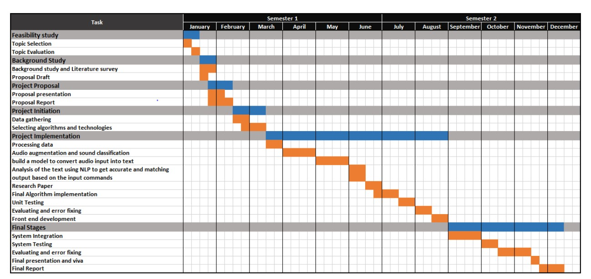
Gantt chart
IT20641092 | Wijesinha W.S.S | TMP-2023-24-074

Slide 26

IT20637064 | Anuththara R.M.C
Bachelor of Science (Hons) in Information Technology
Specializing in Software Engineering
Topic – Confirmation of macaque monkeys crop raiding and repelling macaque monkeys
IT20637064 | Anuththara R. M .C | TMP-2023-24-074

Slide 27
Introduction and Background
Method to confirm the presence of macaque monkeys
How do repel macaque monkeys
Alert the farmer about the presence of monkeys
IT20637064 | Anuththara R. M .C | TMP-2023-24-074

Slide 28
Research Gap
Previous researches conducted in the past, The accuracy obtained by the effective utilization of computer vision and machine learning is less than 94% . We provide the accuracy more than 94%.
Alert the farmer with including the current situation of crop
IT20637064 | Anuththara R. M .C | TMP-2023-24-074

Slide 29
References
[6] Sheik Mohammed.S, Dr.T.Sheela, Dr.T.Muthumanickam "Development of Animal-Detection System using Modified CNN Algorithm" Proceedings of the International Conference on Augmented Intelligence and Sustainable Systems (ICAISS-2022)
[7] Yuvaraj Munian, Antonio Martinez-Molina, Miltiadis Alamaniotis "Intelligent System for Detection of Wild Animals Using HOG and CNN in Automobile Applications"
[8] P. Manikandan, A.Thenmozhi , G. Ramesh, T. Ravi Kiran Naidu, K. Vamsinath Reddy, K. BhanuPradeep Kumar Reddy "Crops Protection System from Animals using Arduino" 2021 3rd International Conference on Advances in Computing, Communication Control and Networking (ICACCCN)
[9] Karthikeyan P, Paul Nishanth R, Valarmathi R "CROP FIELD PROTECTION FROM ANIMALS USING CONVOLUTIONAL NEURAL NETWORKS" 2022 1st international Conference on Computational Science and Technology (ICCST)
[10] RAJI C.G, FATHIMA SAFA, JISHANA P, MOHAMMED ADHIL "Early Warning System from Threat of Wild Animals using Digital Image Processing" 2023 3rd International Conference on Smart Data Intelligence (ICSMDI)
[11] Shola Usharani, Gayathri, Rajarajeswari S, D. S. Kishore, Sivakumar Depur "IoT based Animal Trespass Identification and Prevention System for Smart Agriculture" 2023 7th International Conference on Intelligent Computing and Control Systems (ICICCS)
[12] Joel John Kandathil, Aliya Ashraf, James Babu, Jerin Thomas , Joffin Franci "Real Time Recording and Monitoring of Wild Animal Movements" 2022 IEEE 19th India Council International Conference (INDICON)
IT20637064 | Anuththara R. M .C | TMP-2023-24-074

Slide 30
Research Gap
Research Name | Research 1 [6] | Research 2 [7] | Research 3 [8] | Research 3 [9] | Research 3 [10] | Research 3 [11] | Research 3 [12] | System
More than 94% accuracy obtain
When the camera turns on only triggered, rather than being always active.
Ring the nearest buzzer when the attack |  | N/A
Provide alert when the attack |  | N/A
Provide alert including current situation of crop |  | N/A
IT20637064 | Anuththara R. M .C | TMP-2023-24-074

Slide 31
Research Problem
How to Confirm
presence of monkeys & Repel them?
IT20637064 | Anuththara R. M .C | TMP-2023-24-074

Slide 32
Main Objective
Confirmation of macaque monkeys crop raiding and repelling macaque monkeys
IT20637064 | Anuththara R. M .C | TMP-2023-24-074

Slide 33
Sub Objectives
Responds to the output about presence of macaque according to the probability
Getting the input data from the device and saving it in a cloud.
Classify image for effective detection
Implement the model
Give alert for the farmer
Releasing sound through an output device with the high-frequency.
IT20637064 | Anuththara R. M .C | TMP-2023-24-074

Slide 34
Methodology
IT20637064 | Anuththara R. M .C | TMP-2023-24-074

Slide 35





System Architecture
Releasing High Frequency
Store data
Implement a module
Pre-process and label the data
Trigger the Camera
Identify that detected thing is Macaque Monkey or not
Get input data
Detect the
monkeys
Send the Alert to the application
Application
IT20637064 | Anuththara R. M .C | TMP-2023-24-074

Slide 36
Tools and Technologies and algorithms
Programming Languages
Python
Database Service
Azure
Algorithms
CNN
Tools
Visual Studio code ,Version controlling - SourceTree
IT20637064 | Anuththara R. M .C | TMP-2023-24-074

Slide 37
Functional Requirements
Responds to the preliminary output regarding macaque detection
Data Collection and Analysis for Confirmation of macaque detection
Real-time Sound Emission
Notify the farmer about the monkey's crop raiding
IT20637064 | Anuththara R. M .C | TMP-2023-24-074

Slide 38

Non-Functional Requirements
Accuracy
Usability
Reliability
User-friendliness
Efficiency
IT20637064 | Anuththara R. M .C | TMP-2023-24-074

Slide 39
Gantt Chart
IT20637064 | Anuththara R. M .C | TMP-2023-24-074

Slide 40

IT20606756 | Senanayake p.m.
Topic - Analyzing data to elaborate on macaque monkey prevalence and behavior patterns
Bachelor of Science (Hons) in Information Technology
Specializing in Data Science
IT20606756 | Senanayake P.M. | TMP-2023-24-074

Slide 41

Introduction and Background
Do you think that there may be a group of monkeys who are in the habit of damaging crops?
The number of monkeys coming day by day is increasing and not decreasing.
So, if we have some understanding about the directions and behavior they come from, I think we can increase the expected results from this research project.
IT20606756 | Senanayake P.M. | TMP-2023-24-074

Slide 42
References
[1] Bayne K.A.L., H. Mainzer, S. Dexter, G. Campbell, F. Yamada, and S. Suomi. 1991. The reduction of abnormal behaviors in individually housed rhesus monkeys (Macaca mulatta) with a foraging grooming board. Am J Primatol 23:23–35. [PubMed]
[2] Lutz, C.K., Davis, E.B., Ruggiero, A.M. and Suomi, S.J. (2007), Early predictors of self-biting in socially-housed rhesus macaques (Macaca mulatta). Am. J. Primatol., 69: 584-590. https://doi.org/10.1002/ajp.20370
[3] Fuentes, A. (2006), Human culture and monkey behavior: assessing the contexts of potential pathogen transmission between macaques and humans. Am. J. Primatol., 68: 880-896. https://doi.org/10.1002/ajp.20295
[4] Kaburu, SSK, Marty, PR, Beisner, B, et al. Rates of human–macaque interactions affect grooming behavior among urban-dwelling rhesus macaques (Macaca mulatta). Am J Phys Anthropol. 2019; 168: 92–103. https://doi.org/10.1002/ajpa.23722
[5] Sha, J.C.M., Gumert, M.D., Lee, B.P.Y.-H., Jones-Engel, L., Chan, S. and Fuentes, A. (2009), Macaque–human interactions and the societal perceptions of macaques in Singapore. Am. J. Primatol., 71: 825-839. https://doi.org/10.1002/ajp.20710

Slide 43
Research Gap
Predict the future risk to the farmer by analyzing macaque monkey's presence and behavior patterns.
Demonstration of monkey distribution and behavior through data visualization.
IT20606756 | Senanayake P.M. | TMP-2023-24-074

Slide 44
Research Gap
 | Research 1 | Research 2 | Research 3 | Research 4 | Research 5 | System
Predict the behavior
Summarize the previous data and show the distribution
User interface to visualize the behavior patterns
Usage of real data
Real time visualizing
IT20606756 | Senanayake P.M. | TMP-2023-24-074

Slide 45
Main Objectives
Give the farmer a broad idea of the macaque monkey distribution through recent data analysis.
Find out if there is an increase in their arrivals.
Study the data and predict the future threat because of macaque monkey's arrivals.
IT20606756 | Senanayake P.M. | TMP-2023-24-074

Slide 46
Research Problem
When Monkeys Come? Which Direction?
How will the future be?
IT20606756 | Senanayake P.M. | TMP-2023-24-074

Slide 47
Sub Objectives
Pre-processing and summarizing the collected data captured by sound sensors and cameras
The date and time of their arrival.
Sound sensor number that detected their presence.
Analyze the data and point out the patterns in which they arrived.
Implement a machine learning module.
Give a prediction to the farmer about their arrivals or behavior in future periods.
IT20606756 | Senanayake P.M. | TMP-2023-24-074

Slide 48
Methodology
​
IT20606756 | Senanayake P.M. | TMP-2023-24-074

Slide 49

System Architecture
Monkeys
Farmer
Detect the sounds
ML module
Provide details of what he wants to know
Sound sensor
Implement a module
Store data
Pass the predicted result
Cloud service
Pre-process and label the data
Camera
Detect the
monkeys
Mobile device
Display the behavioural patterns in an appropriate way
Monkeys
Visualization Tool
IT20606756 | Senanayake P.M. | TMP-2023-24-074

Slide 50

Tools and Technologies and algorithms
Programming language
Python
Tools
Version controlling – SourceTree
Visual Studio Code
Google Colab
Data Visualization Tool
Database Service
Microsoft Azure
Algorithms
CNN
IT20606756 | Senanayake P.M. | TMP-2023-24-074

Slide 51
Functional Requirements
Feature Extraction - Time domain extraction.
Machine Learning Model - Implement a suitable machine learning algorithm or model.
Behavior Prediction and Forecasting - Deploy the trained model to predict the monkey behaviors based on their arrival patterns.
Visual User Interface - Develop a user-friendly interface to interact with the system to obtain behavioral predictions or analysis results.
Model Updates - Implement a mechanism to update and retrain the machine learning model periodically to accommodate changes in monkey behavior patterns.
IT20606756 | Senanayake P.M. | TMP-2023-24-074

Slide 52
Non-Functional Requirements
Accuracy
Usability
Reliability
User-friendliness
Efficiency
IT20606756 | Senanayake P.M. | TMP-2023-24-074

Slide 53
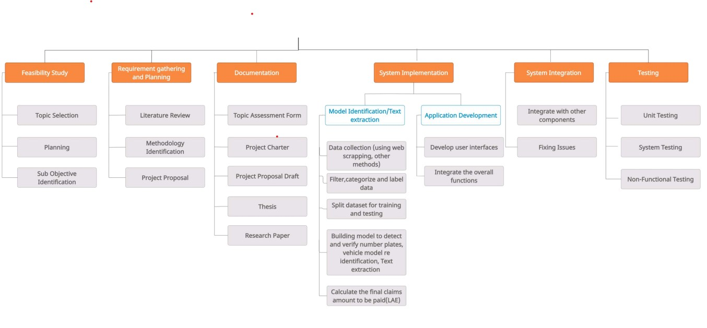
Work Breakdown Structure
Increasing the effectiveness of cultivation by preventing external damage to the cultivation

Slide 54
Gantt Chart
IT20606756 | Senanayake P.M. | TMP-2023-24-074

Slide 55

IT20600334 | Withanage P.W.E.L.
Bachelor of Science (Hons) in Information Technology
Specializing in Data Science
Topic - Identification and Give Solutions to existing crop damages
IT206000334 | Withanage P.W.E.L. | TMP-2023-24-074

Slide 56

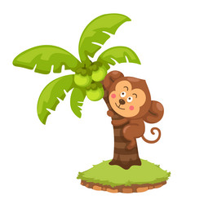
Introduction and Background
What are the most affecting diseases present in crops damaging by Toque macaque in Sri Lanka.
Identifying and diagnosing crop Diseases and Pest Infestations.
[Coconut bug, Caterpillars, Leaflets, yellowing, ....]
How to Address Crop Diseases and Pest damages Once Identified for effective management and control.
IT206000334 | Withanage P.W.E.L. | TMP-2023-24-074

Slide 57
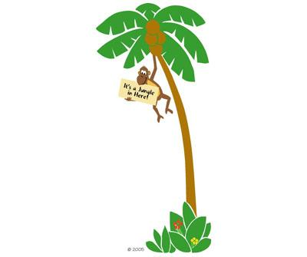
Research Gap
In Sri Lanka, existing Coconut tree disease and pest damage detection systems are only focused on only coconut leaf diseases. No proper existing system to recognize both diseases and pest damages and provide solutions.
IT206000334 | Withanage P.W.E.L. | TMP-2023-24-074

Slide 58
Research Gap
 | Research 1 | Research 2 | Research 3 | Research 4 | Research 5 | System
Provide solutions after detection
Provide the information about people & companies can provide services on solutions
Identify damaged parts from all the parts in the tree
Identify both pest damages and diseases
Provide mobile application system
[41]
[42]
[43]
[44]
[45]
IT206000334 | Withanage P.W.E.L. | TMP-2023-24-074

Slide 59

Research Problem
How to Identify & find the solutions for these damages in
Coconut crop?
IT206000334 | Withanage P.W.E.L. | TMP-2023-24-074

Slide 60
Specific Objectives
Develop an efficient and reliable disease identification system
Improve coconut crop productivity and reduce losses
Enhance agricultural sustainability and support the export crop industry
Path to Main Objective
The Impact of Pests and Diseases on Coconut Crops
Need for a Disease & pest damage Identification System
Needs Correct Solutions
IT206000334 | Withanage P.W.E.L. | TMP-2023-24-074

Slide 61
Sub Objectives
Data Collection and Compilation
Gather a dataset of images specific to diseases of the crop.
Label each image with the corresponding disease type.
Utilize a deep learning architecture, such as a convolutional neural network (CNN), to train a model on the labeled image dataset.
Train the model and identify the diseases.
Give solutions
IT206000334 | Withanage P.W.E.L. | TMP-2023-24-074

Slide 62
Methodology
IT206000334 | Withanage P.W.E.L. | TMP-2023-24-074

Slide 63

System Architecture
damaged
Coconut tree part image
Identify the image is coconut tree part or not
damaged
Coconut tree part image
Upload damaged
Coconut tree part image
Identify the coconut infected a disease or not
SDP
DB
SDP
SDP
Identify the infected disease
Application
What are the Solutions for the disease
Who are the people can provide treatments in User's area
SDP – Solution Details Pack
IT206000334 | Withanage P.W.E.L. | TMP-2023-24-074

Slide 64

Tools and Technologies and algorithms
TECHNOLOGIES
Development – Python
Identification - OpenCV
Building model - Visual Studio Code, Google Colab, Tensorflow and Keras
Technology stack
Version controlling - GitLab
Algorithms
CNN
SVM
IT206000334 | Withanage P.W.E.L. | TMP-2023-24-074

Slide 65
Functional Requirements
The system should allow farmers or users to easily input crop images, field data, and other relevant information.
Disease Identification and Classification.
Provide real-time feedback to farmers about the health status of their crops.
Offer appropriate recommendations for disease management and control strategies.
IT206000334 | Withanage P.W.E.L. | TMP-2023-24-074

Slide 66

Non-Functional Requirements
Accuracy
Usability
Reliability
User-friendliness
Efficiency
IT206000334 | Withanage P.W.E.L. | TMP-2023-24-074

Slide 67
Work Breakdown Structure
Increasing the effectiveness of cultivation by preventing external damage to the cultivation
IT206000334 | Withanage P.W.E.L. | TMP-2023-24-074

Slide 68
Gantt Chart
July
Aug
Sep
Oct
Nov
Dec
Jan
Feb
Mar
Apr
May
June
IT206000334 | Withanage P.W.E.L. | TMP-2023-24-074

Slide 69
References
[41] Nivethitha T. , "A Review on Coconut Tree and Plant Disease Detection using various Deep Learning and Convolutional Neural Network Models" in 2022 International Conference on smart and sustainable technologies in energy and power sector(SSTEPS)
[42] Bharathi. S., Harini p. "Early Detection of Diseases in Coconut Tree Leaves" in 2020 6th International Conference on Advanced Computing and Communication Systems (ICACCS)
[43]S. P Vidhanaarachchi , P.K.G.C. Akalanka , R.P.T.I. Gunasekara , H.M.U.D. Rajapaksha , N.S. Aratchige , Dilani Lunugalage , Janaka L. Wijekoon , "Deep Learning-Based Surveillance System for Coconut Disease and Pest Infestation Identification" in TENCON 2021 - 2021 IEEE Region 10 Conference (TENCON) 7-10 Dec 2021. Auckland, New Zealand
[44]Dhapitha Nesarajan, Lokini Kunalan, Mithun Logeswaran, "Coconut Disease Prediction System Using Image Processing and Deep Learning Techniques" in 2020 IEEE 4th International Conference on Image Processing, Applications and Systems (IPAS)
[45]Deepak Banerjee, Vinay Kukreja, Satvik Vats, Vishal Jain, Bhawna Goyal, "Enhancing Accuracy of Yellowing Disease Severity Level Detection in Coconut Palms with SVM Regularization and CNN Feature Extraction " in 2023 Third International Conference on Secure Cyber Computing and Communication (ICSCCC)
IT206000334 | Withanage P.W.E.L. | TMP-2023-24-074

Slide 70

Budget & Budget Justification

Slide 71
Budget & Budget Justification
Product | Cost
Speakers | ~LKR 6000.00
Mic | ~LKR 2500.00
Camera | ~LKR 4000.00
ESP32 | ~LKR1700.00
Cloud Cost – Azure | ~ LKR 4000.00
Internet Cost | ~ LKR2000.00
Publication | ~LKR8500.00
Total | ~LKR28700.00

Slide 72
Thank You!

